Slide 1
American Institutes for Research /
National Center on Family Homelessness
Transitional Housing for Survivors of Domestic and Sexual Violence: A 2014-15 Snapshot
Project Methodology / Approach

Slide 2
Transitional Housing for Survivors of Domestic and Sexual Violence:
A 2014 –15 Snapshot
Presenter:
Fred Berman, Senior Associate, American Institutes for Research / National Center on Family Homelessness
  This project was supported by Grant No. 2012-TA-AX-K003 awarded by the Office on Violence Against Women, U.S. Department of Justice. The opinions, findings, conclusions, and recommendations expressed in this publication are those of the author and do not necessarily reflect the views of the Department of Justice, Office on Violence Against Women.

Slide 3
What’s on the Project Webpage?
The project webpage is www.air.org/THforSurvivors. The webpage contains links to
The 12 chapters of the Report, each with an executive summary and a reference list;
The Methodology webinar and four Overview webinars;
Four brief podcast interviews highlighting the approaches of some of the providers we interviewed; and
Broadsides highlighting two of the many important topic areas this report addresses.

Slide 4
Chapters of the Report (Overview Webinar #1)
#01 - Definition of “Success” & Performance Measurement
#02 - Survivor Access and Participant Selection
#03 - Program Housing Models
#04 - Taking a Survivor-Centered / Empowerment Approach: Rules Reduction, Voluntary Services, Participant Engagement

Slide 5
Chapters of the Report (Overview Webinar #2)
#05 - Program Staffing
#06 - Length of Stay
#07 - Subpopulations and Cultural / Linguistic Competence
#08 - OVW Constituencies (Domestic Violence - Dating Violence - Sexual Assault - Stalking +Trafficking)

Slide 6
Chapters of the Report (Overview Webinars #3 & 4)
#09 - Approach to Services: Basic Support and Assistance
#10 - Challenges and Approaches to Obtaining Housing and Financial Sustainability
#11 - Trauma-Specific and Trauma-Informed Services for Survivors and Their Children
#12 - Funding and Collaboration: Opportunities and Challenges

Slide 7
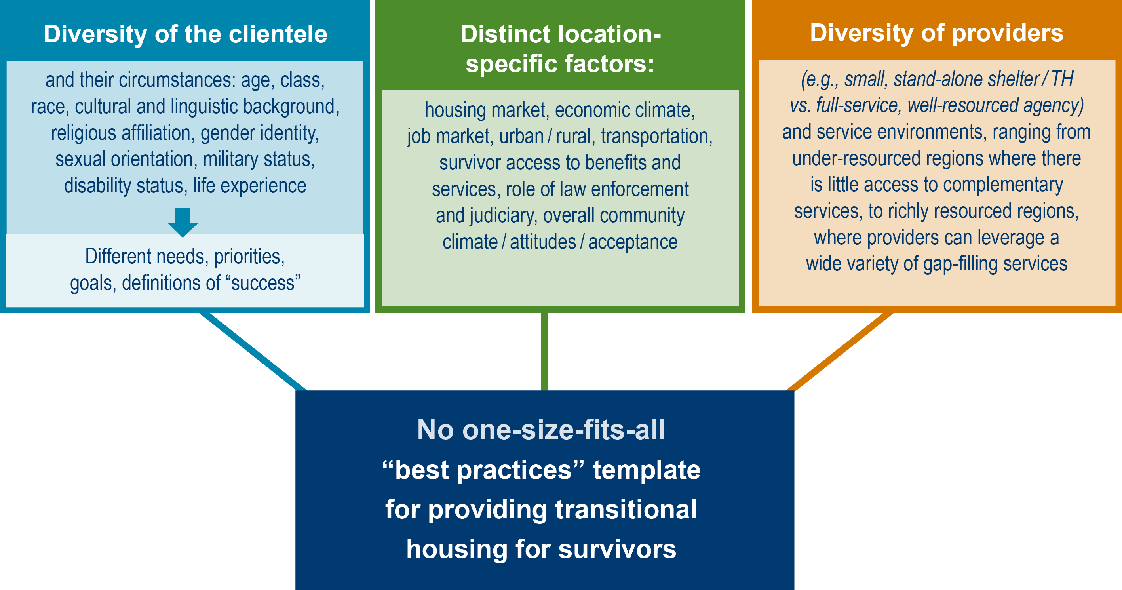
Overall Project Approach

Slide 8
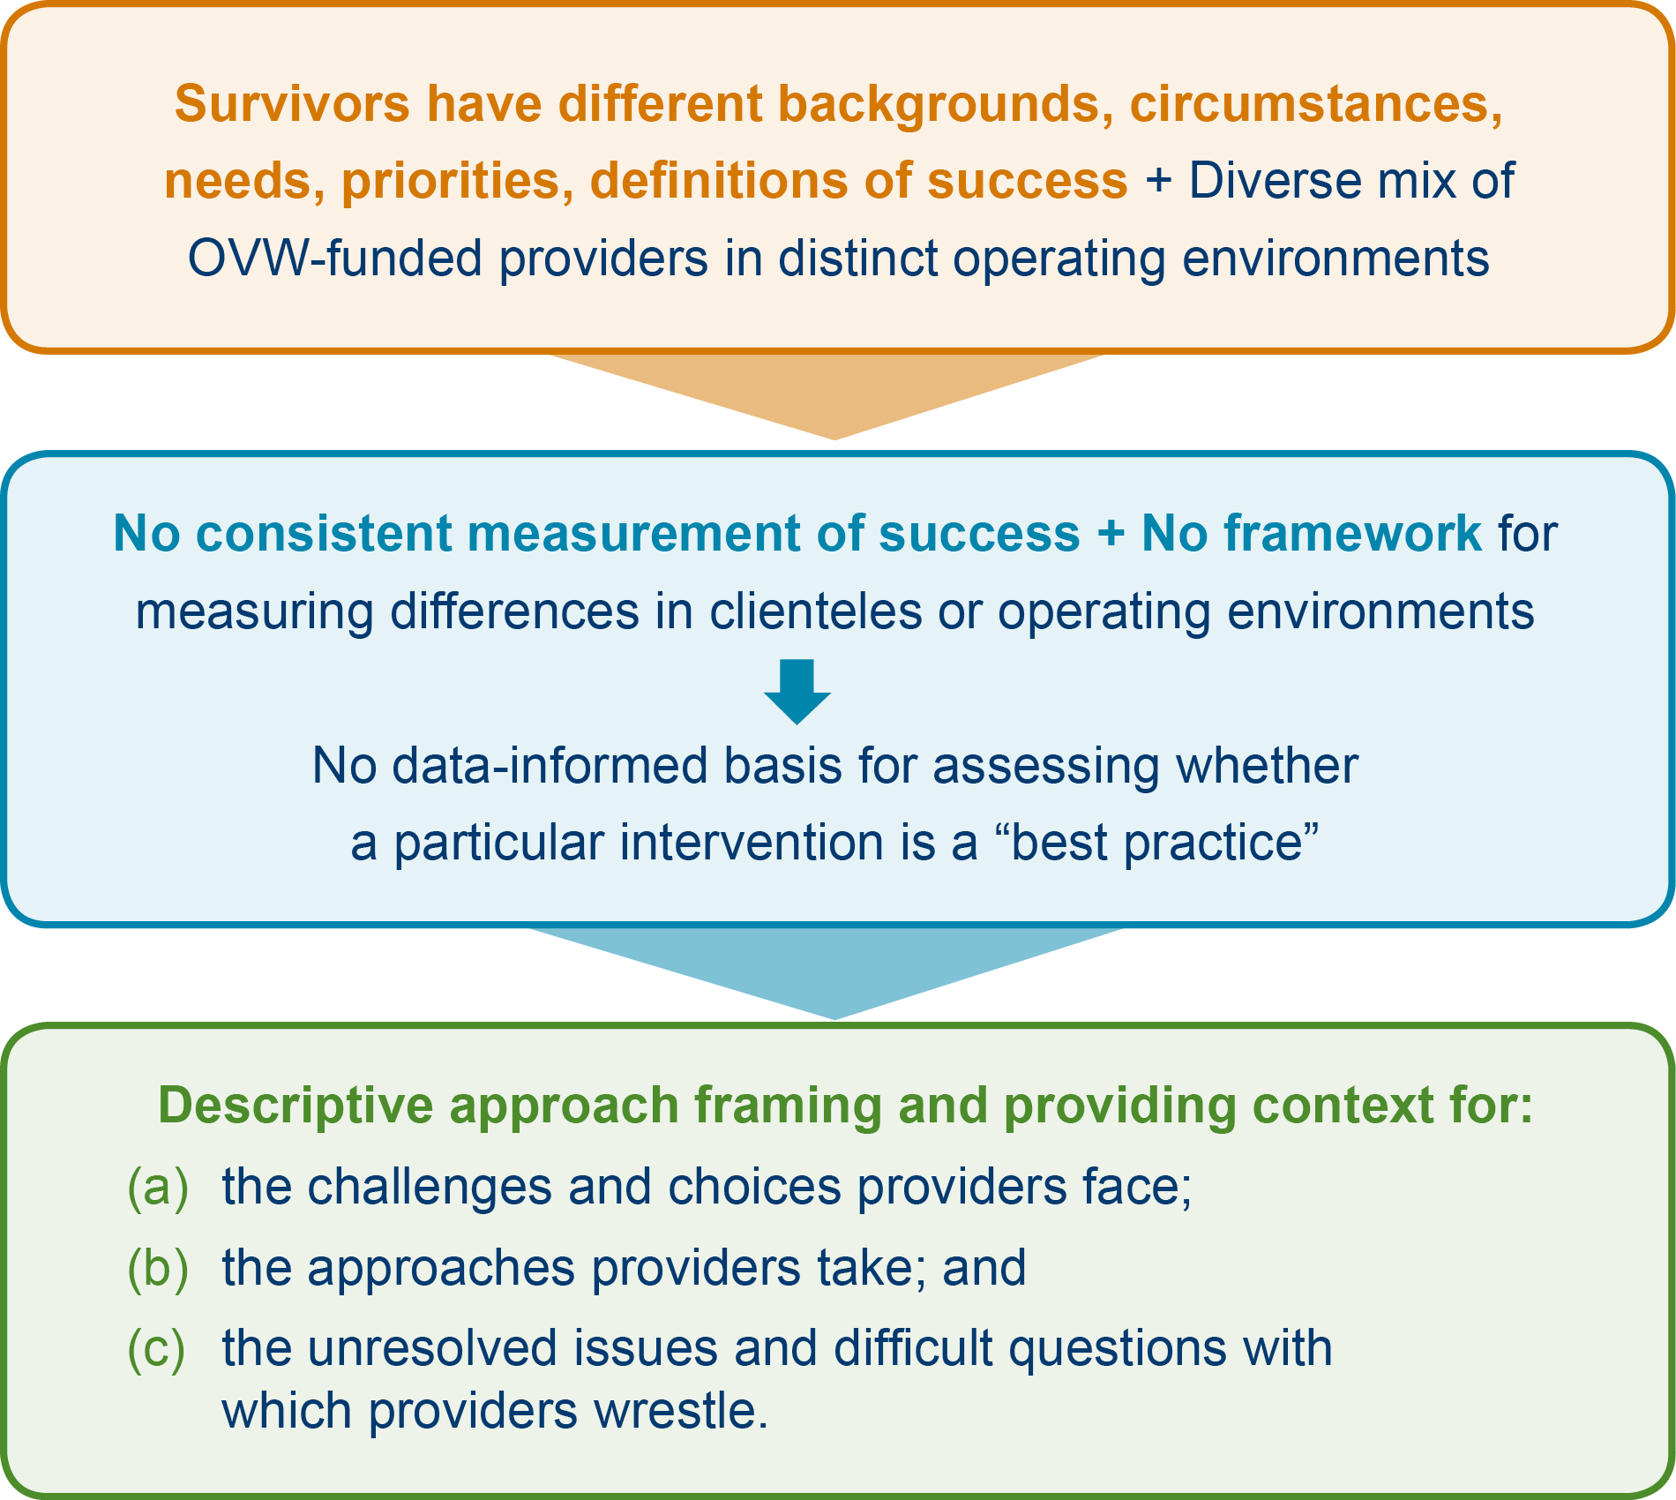
Overall Project Approach (cont.)

Slide 9
Getting Started /Initial Interviews
Review of the literature
Draft of interview questions
Discussions and “dry runs” with Project Advisory Team
Revisions to interview questions
Development of Interview Protocol
“Field test” with nine TH programs identified by OVW
Revisions to interview Protocol
50+ interviews, with periodic updates to the Protocol

Slide 10
Mid-Course Analysis
Input de-identified interview transcripts into NVivo Software
Code provider answers according to topic area discussed
Compile interview excerpts addressing specific topic areas
Send topic-specific sets of de-identified provider comments to Project Advisory Team
13 Topic-specific discussions with Project Advisory Team – (a) what are providers telling us? (b) what questions do provider comments raise? (c) what additional information is needed? (d) which questions can we stop asking? etc.
Ongoing literature review

Slide 11
Finishing Data Collection / Integration
Periodic revisions to Protocol and to the Coding Protocol
Another 70 TH provider interviews + two “special” interviews
Finish coding and de-identifying all interview transcripts
Compile interview excerpts addressing specific topic areas
Consolidate provider comments: (a) include all possible comments; (b) edit for clarity and brevity, preserve content; and (c) keep comments in chronologic order, avoiding bias
Consolidate / reorganize taxonomy of topics for clarity
Continue literature review

Slide 12
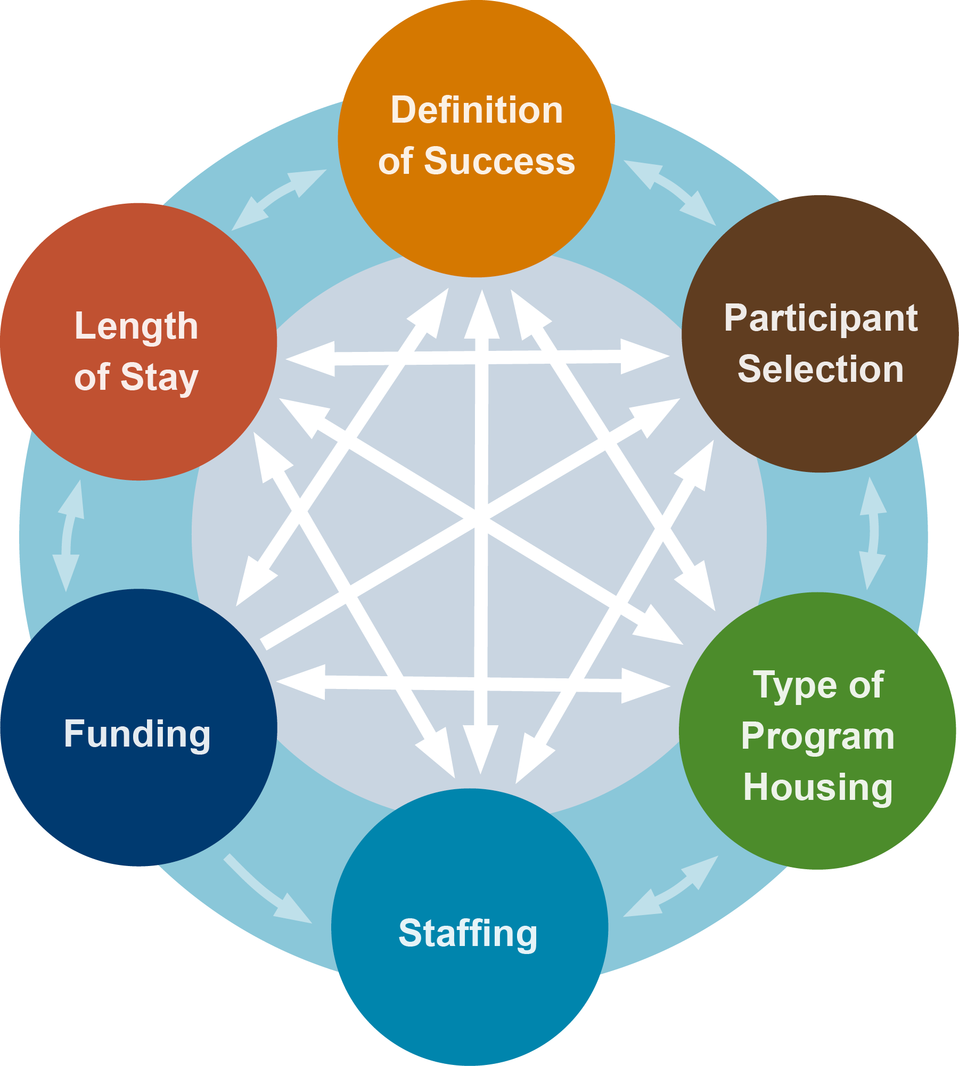
The topics are interrelated.

Slide 13
Thank You!
Thank You!
For more information visit: www.air.org/THforSurvivors
Fred Berman,
Senior Associate
American Institutes for Research
National Center on Family Homelessness
201 Jones Rd. – Suite #1
Waltham, MA 02451
Telephone: 781-373-7065
Email: fberman@air.org
Barbara Broman,
Managing Director
American Institutes for Research
1000 Thomas Jefferson St. NW
Washington, DC 20007
Telephone: 202-403-5118
Email: bbroman@air.org

