Slide 1
Using Data to Drive community-based approaches to the opioid crisis
#OpioidsData
June 18th 2018

Slide 2
Welcome
Cheryl Vince, Senior Vice President and Institute Fellow,
American Institutes for Research

Slide 3
Opening Remarks
Avenel Joseph, Ph.D., Director of Policy and Oversight
Office of Senator Edward Markey

Slide 4
Panel Discussion
Susan Heil, Principal Researcher, American Institutes for Research
Marian Ryan, District Attorney, Middlesex County, MA
Xavier “Laurence” Andrews, Executive Director, Prevention Alliance of Lauderdale, TN
Notes:
Start with overview of briefing; what we’ll cover./ agenda.

Slide 5
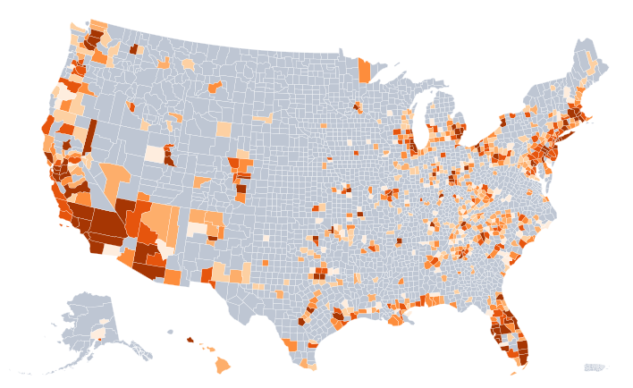
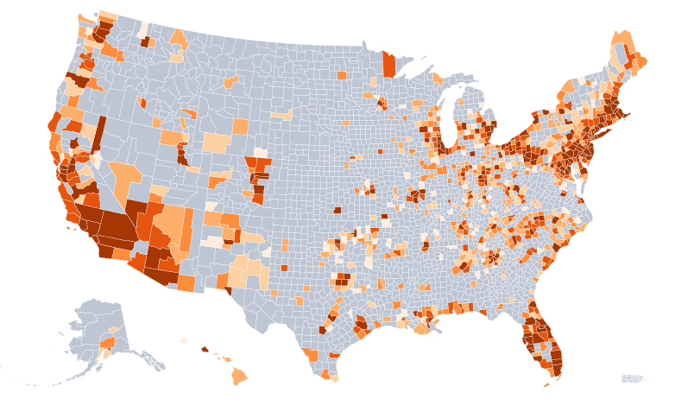






Drug-related Mortality, 2010 and 2016
Number of deaths from prescription or illicit drug poisoning
2010
2016
Source: Maps generated through the amfAR Opioid and Health Indicators database: http://opioid.amfar.org/indicator/drugdeaths based on CDC Wonder data: Centers for Disease Control and Prevention, National Center for Health Statistics. About Multiple Cause of Death 1999-2016. CDC WONDER Online Database, released December 2017..
Notes:
Call out a few key trends, changes over time;
Darker=more; places that were “hot” are generally still “hot”, and “hotter”.
“Filling in” of the East Coast, Midwest, Eastern half of country, as well as wider expanses going “hot” in the west.
Inconsistent quality of death certificate data requiring a look at “drug-related mortality” vs. opioid on this master map (CDC recommendation)
*** In 2016 there were 63,600 drug overdose deaths in the US, 2/3 of which involved an opioid drug: 42,249 opioid-involved deaths.
Hip pocket:
Significant increases in drug overdose death rates from 2015 to 2016 were seen in the Northeast, Midwest and South Census Regions. States with statistically significant increases in drug overdose death rates included Connecticut, Delaware, Florida, Illinois, Indiana, Kentucky, Louisiana, Maine, Maryland, Massachusetts, Michigan, Minnesota, Missouri, New Jersey, New York, North Carolina, Ohio, Oklahoma, Pennsylvania, South Carolina, Tennessee, Texas, Vermont, Virginia, West Virginia, and Wisconsin.¹

Slide 6
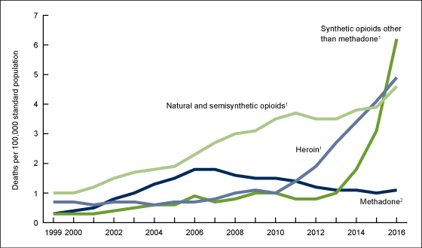
Opioid-involved drug poisoning deaths
Between 2010 and 2016:
The number of U.S. opioid-related deaths has doubled: 42,249 vs. 21,089
The age-adjusted opioid-related death rate has doubled: 13.3 vs. 6.8 (per 100,000)
Opioid-related deaths by opioid drug type have dramatically changed
Age-adjusted drug overdose death rates, by opioid category: United States, 1999–2016
Reprinted from: Hedegaard H, Warner M, Miniño AM. Drug overdose deaths in the United States, 1999–2016. NCHS Data Brief, no 294. Hyattsville, MD: National Center for Health Statistics. 2017.
Source: National Center for Health Statistics, National Vital Statistics System, Mortality

Slide 7

Defining Local Strategies to Prevent and Reduce Misuse
Multi-disciplinary steering committee
Examine local data across systems to identify pressing problems
Identify and calibrate resources/assets with readiness to respond
Learnings: Resource maps, stakeholder input and cross-systems discussions are shaping local strategies rooted in evidence
Partnership with Middlesex County District Attorney’s Office
Notes:
Multi-disciplinary steering committee driving the work

Slide 8
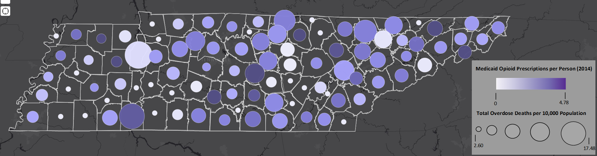
Generating Community Solutions to End the Opioid Epidemic Using Community Data Interpretation
Local multi-stakeholder interpretation of data
Data visualizations help establish common ground; springboard to problem identification and solutions
Learnings: Lived and professional expertise of stakeholders gives local meaning to data and evidence based solutions
Opioid Response Planning Checklist: coalition tool for self-assessment and planning for promising solutions
Data Visualization Example: Overdose Deaths per 10,000 and Medicaid Opioid Prescriptions per Person, 2014
Sources: Data on the number of overdose deaths come from the County Health Rankings, produced by the Robert Wood Johnson Foundation from various national and state data sources. Data on Medicare opioid prescriptions come from the Centers for Medicaid and Medicare Services.
Notes:
“give meaning” to the data– learn from expertise about what’s driving the data at a local level; meeting the needs of the local drivers with an applicable EBP.
CDI Consists of 5 Steps:
1. Interpret Data
2. Prioritize a Need
3. Identify a Promising Practices
4. Identify Driving & Restraining Forces
5. Knowledge Sharing
SANJAY:
Under the direction of the State of Tennessee Department of Health, AIR facilitated three workshops in Nashville, Knoxville, and Memphis
Developed cross-systems teams representing local health, law enforcement, criminal justice, substance abuse and mental health, treatment, and the faith-based communities. Community members who are in recovery also attended
Data visualizations help establish key findings in the context of lived and professional expertise of participants
Evidence-based promising practices ground solutions and open a dialog for interventions in communities given their readiness and capacity
Opioid Response Planning Checklist: post-workshop drug coalition tool for self-assessment and strategic planning

Slide 9
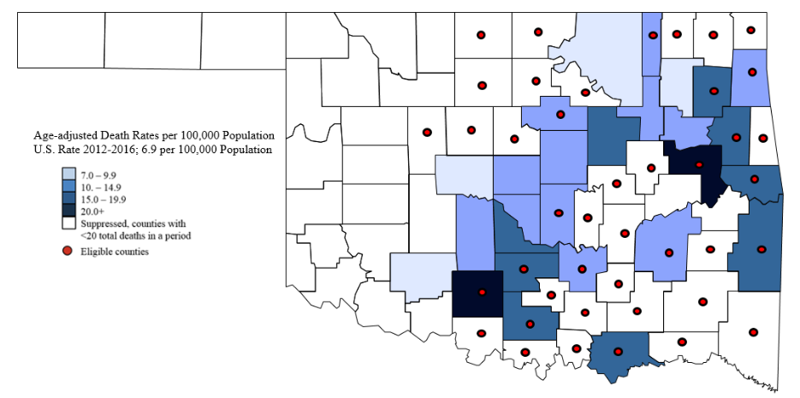
Expanding Rural Access to OUD Treatment Medications
Primary care practices
Provider training and mentorship initiative (including ECHO model opportunities)
Key learnings so far: barriers, facilitators, training needs, provider engagement
AIR’s partners: Oklahoma Department of Mental Health and Substance Abuse Services, American Society of Addiction Medicine, University of New Mexico
County-level opioid-involved drug poisoning mortality rates, 2012 through 2016, and OklahomaMAT-eligible counties
Source: Adapted from Centers for Disease Control and Prevention, National Center for Health Statistics. Multiple Cause of Death 1999-2016 on CDC WONDER Online Database, released 2017. Data are from the Multiple Cause of Death Files, 1999-2016, as compiled from data provided by the 57 vital statistics jurisdictions through the Vital Statistics Cooperative Program. Accessed at http://wonder.cdc.gov/mcd-icd10.html May-18.
Notes:
“data” isn’t just quantitative– needs assessment informs design, approach
Data on prevalence and opioid-related mortality drove selection of counties

Slide 10
Scope of the Problem: 2012-2016

Slide 11
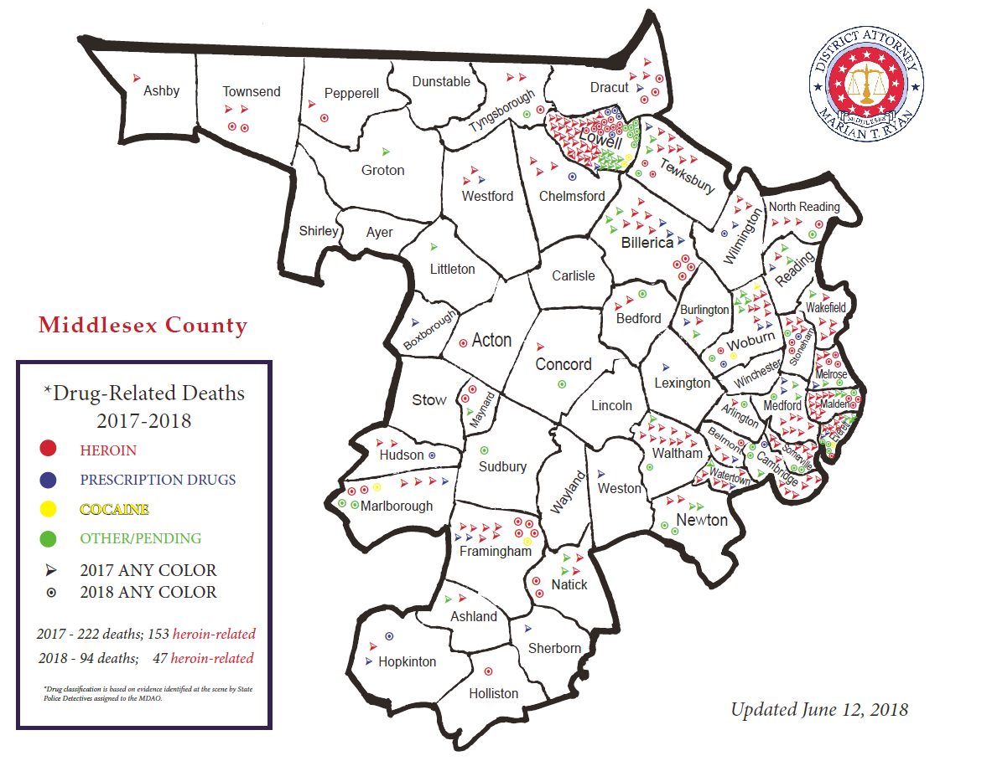
Scope of the Problem: 2017-2018

Slide 12

MDAO’s Multipronged Approach
Education
Prevention
Legislation
Enforcement
Intervention
Treatment

Slide 13
Scope of the Problem:
Inside the Numbers

Slide 14
Panel Discussion
Susan Heil, Principal Researcher, American Institutes for Research
Marian Ryan, District Attorney, Middlesex County, MA
Xavier “Laurence” Andrews, Executive Director, Prevention Alliance of Lauderdale, TN

Slide 15
Question & Answer Session
Susan Heil, Principal Researcher, American Institutes for Research

Slide 16
Learn more at AIR’s center for Multi-system solutions to the opioid epidemic: https://www.air.org/center/center-multi-system-solutions-opioid-epidemic
Contact: Susan K. R. Heil
Principal researcher
SHeil@air.org
Follow the conversation online with #OpioidsData

