Slide 1

Professional Learning with Impact
Workshop: Breakout Rooms
Fall 2021
Professional Learning with Impact Workshop: Breakout Rooms. Fall 2021. This work is licensed under a Creative Commons Attribution-NonCommercial-ShareAlike 4.0 International (CC BY-NC-SA 4.0) License.
The contents of this slide deck were developed under a grant from U.S. Department of Education, Office of Elementary and Secondary Education, Award No. U411B180032; However, those contents do not necessarily represent the policy of the Department of Education, and you should not assume endorsement by the Federal Government.

Slide 2

In your breakout room, select:
Facilitator - leads discussions
Recorder - takes notes to share with the whole group
Time Keeper - keeps track of time
Technology Lead - operates the technology in breakout rooms

Slide 3
4R’s: Round Robin, Rapid Recall
In break out rooms by school teams,
recall key ideas for each FFT Cluster in round-robin fashion.
There will be 1 minute for each FFT Cluster.
Each person will share key ideas of the FFT Cluster until time up.
There will be a broadcast when it is time to move to the next FFT Cluster.

Slide 4

COLLABORATIVE CONVERSATION SKILLS CARD SORT
In Breakout Rooms:
Open the jamboard for your district.
Analyze each statement or questions or similarities and differences:
Which prompt thinking?
Which ones might you feel comfortable or confident answering?
Sort the statements and questions into two groups/piles:
invites thinking
doesn’t invite thinking

Slide 5
Practicing Skills
In breakout rooms with a partner:
Determine who is A and who is B.
A shares responses to the two questions:
Which skills are already part of your repertoire?
What might be some skills to add next to your repertoire?
B practices asking invitational questions and paraphrasing.
Reverse roles.

Slide 6
How do teachers have voice and choice?
In the breakout rooms with school teams,
each person shares the annotations they made for voice or choice.
What questions might you have about coaching rounds?
Notes:
8 min

Slide 7
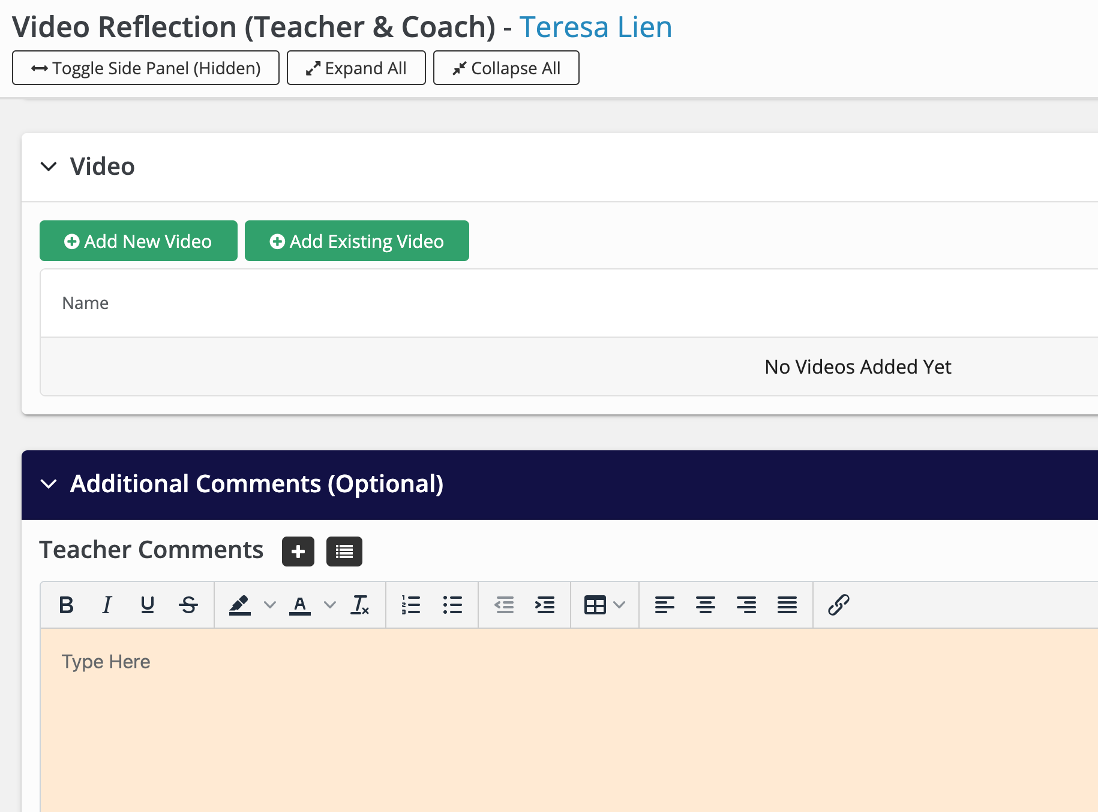
Your Turn!
In breakout rooms with a partner,
practice uploading a video in your own account and tag with comments to your coach.
Think collaborative conversation skills.
Use the Your Turn document to navigate through this exercise
If you do not have a video of your own, use the video provided in the Your Turn document.
Notes:
15 min

Slide 8
Stage 1: Analyze Data: Review
01
02
03
Review/Skim Stage 1 in Manual (pg. 21-23 )
In breakout rooms, read the reflective statements around data and determine your most comfortable and your least comfortable for your team.
Each team share out their most comfortable or their least
Notes:
Share out:
what can we share with each other to support our comfort/skills with data analysis?

Slide 9
Stage 1: Analyze Data: Review
We collect data to determine gaps between our vision and current state.
2. We know what types of data we will need to access regularly to define our current state and we know how to access them.
3. We are confident that we have the skills and knowledge to interpret and use data to guide decisions about learning and improvement.
4. We can create a safe environment for analyzing data so team members are comfortable discussing potentially difficult topics.
5. We know what data we will regularly collect to inform our current learning and improvement process.
6. We know how to use protocols to support the data analysis stage.
7. We know what information is available to define our desired state and we know where to find it.

Slide 10

Matching Goal Statements
Examine the student and educator goals in the Jamboard.
Read the goals and match the educator goal with the student goal that it supports
Notes:
4 min

Slide 11
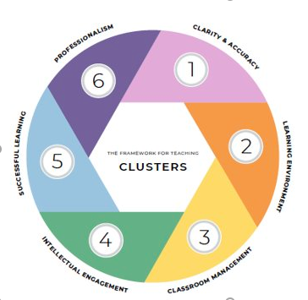
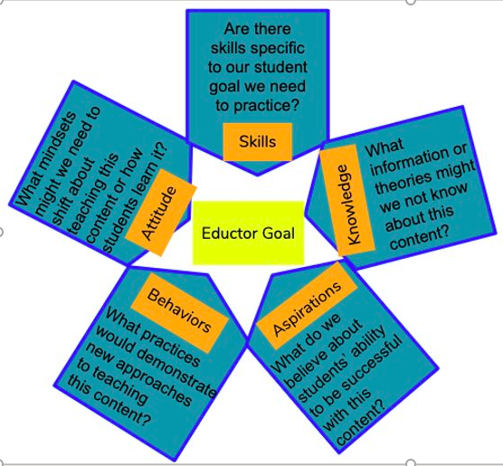
Application of KASAB
Go back to the three examples of Team Learning Goals:
  As you review the educator goal through the lens of KASAB, what elements of that framework stand out?
  Which of the FFT clusters might be the focus of this goal? How do you know?
Notes:
https://docs.google.com/document/d/1EvH5XhiB6tUDdFczUGfGR4rotGskifAWVREOwSSHLAI/edit?usp=sharing
5 min

Slide 12
Stages 4 & 5:
01
02
03
Jigsaw the guidebook sections for Stage 4 & 5
Dig Deeper into each stage using the narrative and protocols
Find an image/metaphor that how these 2 stages are different from Stages 1-3
Be ready to share out in whole group during the debrief
Notes:
Ask questions
All learning together
Be an active contributor
1 min

Slide 13
Stage 4 & 5: Deeper Dive Part 2
Drilling Down to the Details
Stage 4 Practice
Read the stage 4 narrative on pg. 64 in the Guidebook.
As you consider this team’s journey, what do you anticipate might be similar to yours? What might be different?
Read through the protocol on page 37.
Consider which step might prove the most challenging.
Where will you get the support needed to complete that step?
Stage 5 Practice
Read the stage 5 narrative on pg. 65-66 in the Guidebook.
As you consider this team’s journey, what do you anticipate might be similar to yours? What might be different?
Read through the protocol on page 41.
Consider which step might prove the most challenging.
Where will you get the support needed to complete that step?
Jigsaw pages 34-41
pgs. 34-35
pgs. 36-37
pags. 38-41
For now, leave out the protocol as you jigsaw.
Share out your learning with the other two sections.
Notes:
Similar
Guiding questions and key actions and protol beginning on page 36
(5 min)

Slide 14
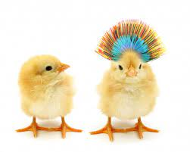
Create an Image or a Metaphor that Explains….
How are these last two stages
different from the first three?

